Slide 1


Learning Cooperative Policies with Graph Networks in Distributed Swarm Systems
汇报人
傅连浩
2023年9月18日
[1] T. Zhang, Z. Liu, Z. Pu, J. Yi, X. Ai and W. Yuan, "Learning Cooperative Policies with Graph Networks in Distributed Swarm Systems," 2023 International Joint Conference on Neural Networks (IJCNN), Gold Coast, Australia, 2023, pp. 1-8, doi: 10.1109/IJCNN54540.2023.10191136.

Slide 2
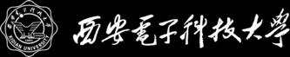
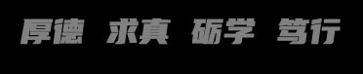
目录
CONTENTS
01
Introduction and Background
02
Method
03
04
Comments
Simulations

Slide 3

PART 1
Introduction and Background
Distributed Swarm System
DRL in Distributed Swarm System
Observation-level and Communication-level Graphs

Slide 4
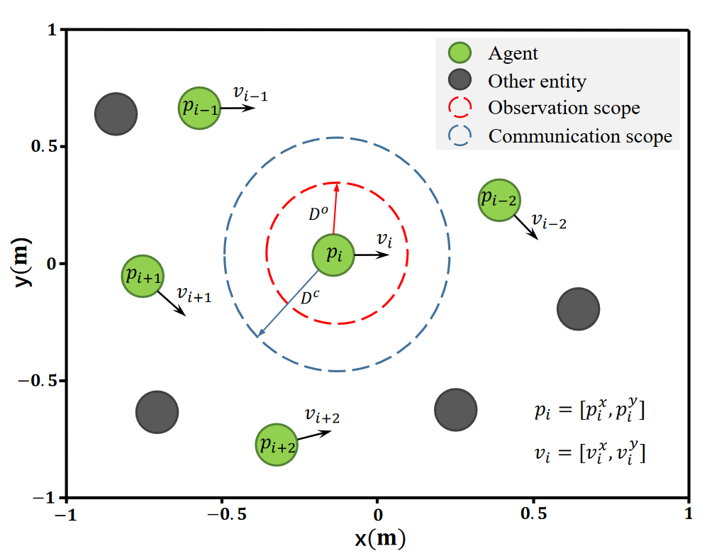
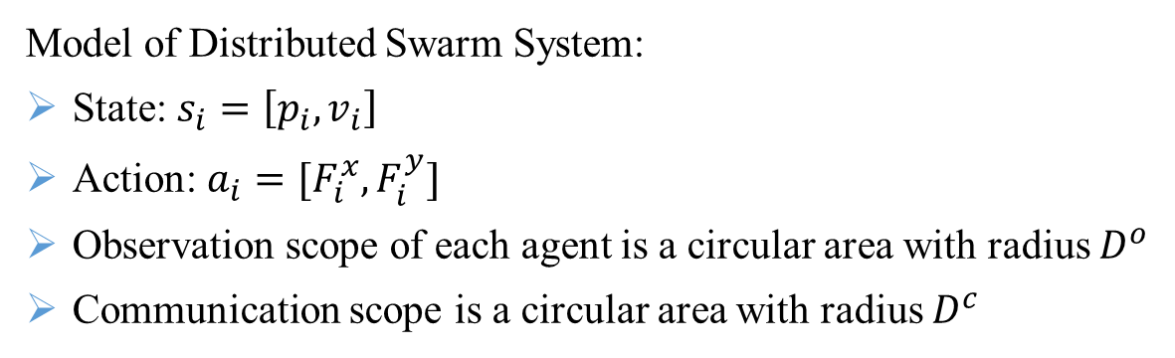
01
Introduction and Background
Distributed Swarm System
Highly Decentralized
Low Cost
Dynamic Adjustment
Independent Coordination
UAV/UGV
Communication Constraint
Manipulation Constraint
Sensing Constraint
Model of Distributed Swarm System:
State: $s_{i}=\left[p_{i},v_{i}\right]$
Action: $a_{i}=[F_{i}^{x}, F_{i}^{y}]$
Observation scope of each agent is a circular area with radius $D^{o}$
Communication scope is a circular area with radius $D^{c}$

Slide 5

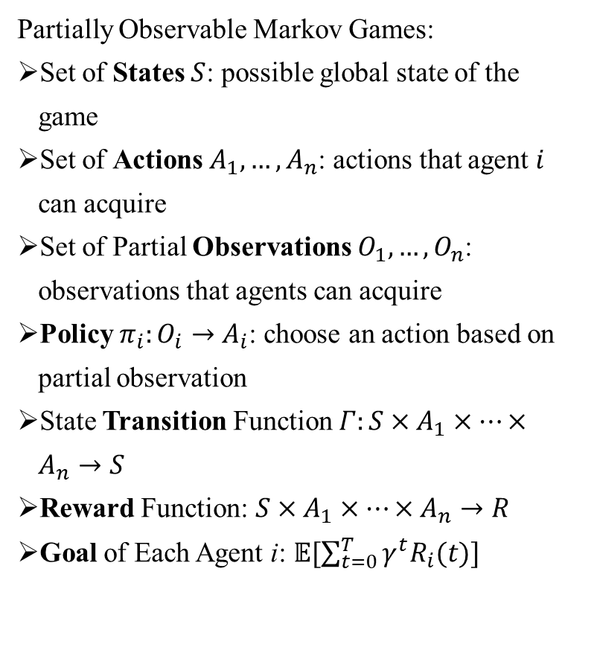
01
Introduction and Background
DRL in Distributed Swarm System
Global Cooperation Mechanisms
Communication among Agents
Partially Observable Markov Games:
Set of States $S$: possible global state of the game
Set of Actions $A_{1},…,A_{n}$: actions that agent $i$ can acquire
Set of Partial Observations $O_{1},…,O_{n}$: observations that agents can acquire
Policy $π_{i}:O_{i}→A_{i}$: choose an action based on partial observation
State Transition Function $Γ:S×A_{1}×…×A_{n}→S$
Reward Function: $S×A_{1}×…×A_{n}→R$
Goal of Each Agent i: $𝔼[\sum_{t=0}^{T}{γ^{t}R_{i}(t)}]$
Joint Value Factorization
High Dimensionality of State and Observation Information
Changing of the Available Information Set Size

Slide 6
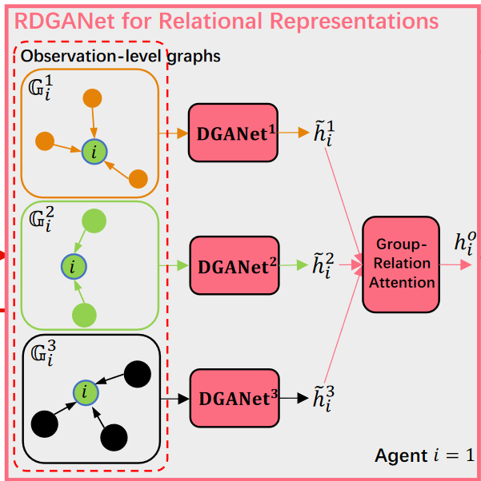
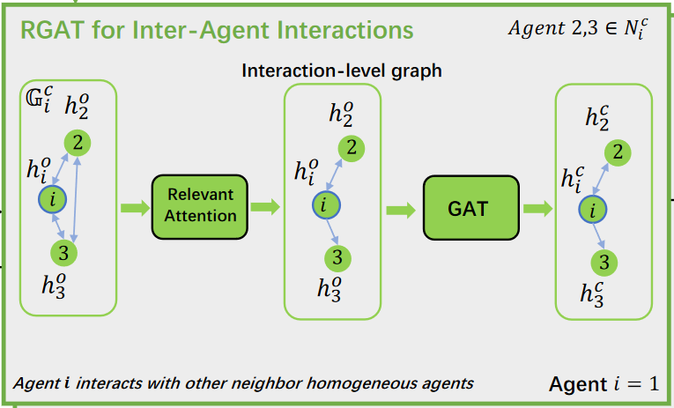
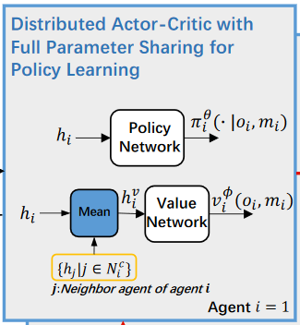
01
Introduction and BackGround
Observation-Level: model observation-level graphs composed of heterogeneous relational graphs among each agent and each type of entities for extracting different relational representations
Communication-Level: model a relevant communication topology among each agent and relevant homogeneous neighbor agents as an communication-level graph
Parameter Sharing: distributed actor-critic algorithm with full parameter sharing is implemented to learn cooperative swarm policies

Slide 7
PART 2
Method
Overall Structure of Proposed Method
RDGANet for Different Relational Representations
RGAT for Efficient Inter-Agent Interactions
Distributed Actor-Critic

Slide 8
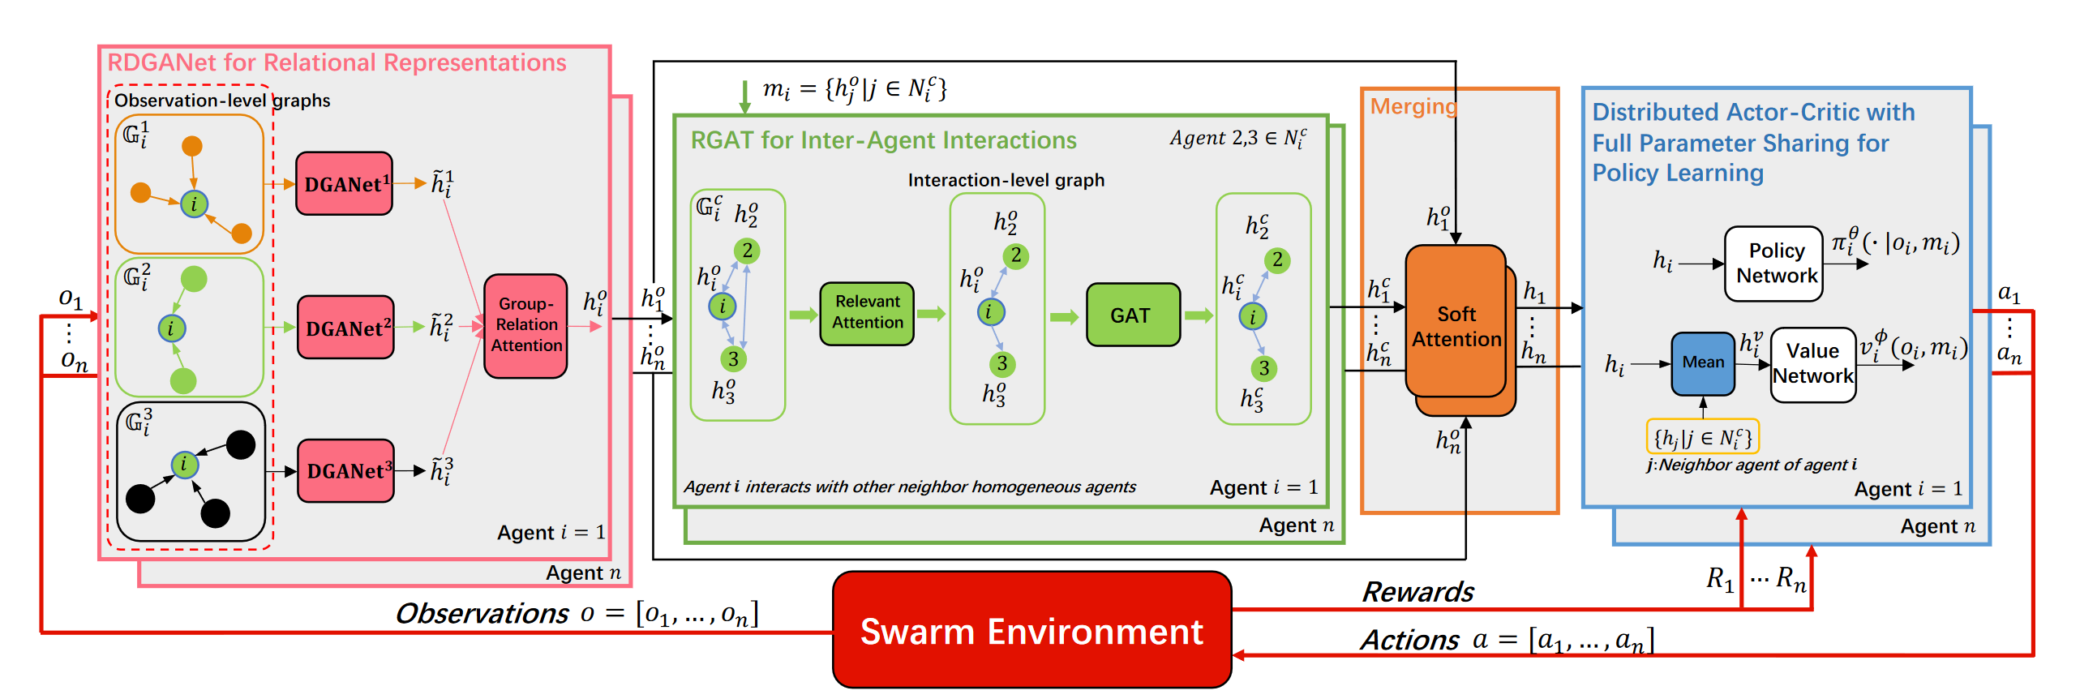
02
Method
Overall Structure
Model observation-level graphs with different types of groups
Embed observations in different groups
Aggregate information from different groups
Cut off the ineffective communication between unrelated agents
Model a relevant communication topology
Facilitate efficient inter-agent interactions
Merge module with a soft attention mechanism
Implement distributed actor-critic algorithm with full parameter sharing
Use distributional critics to learn cooperative swarm policies

Slide 9
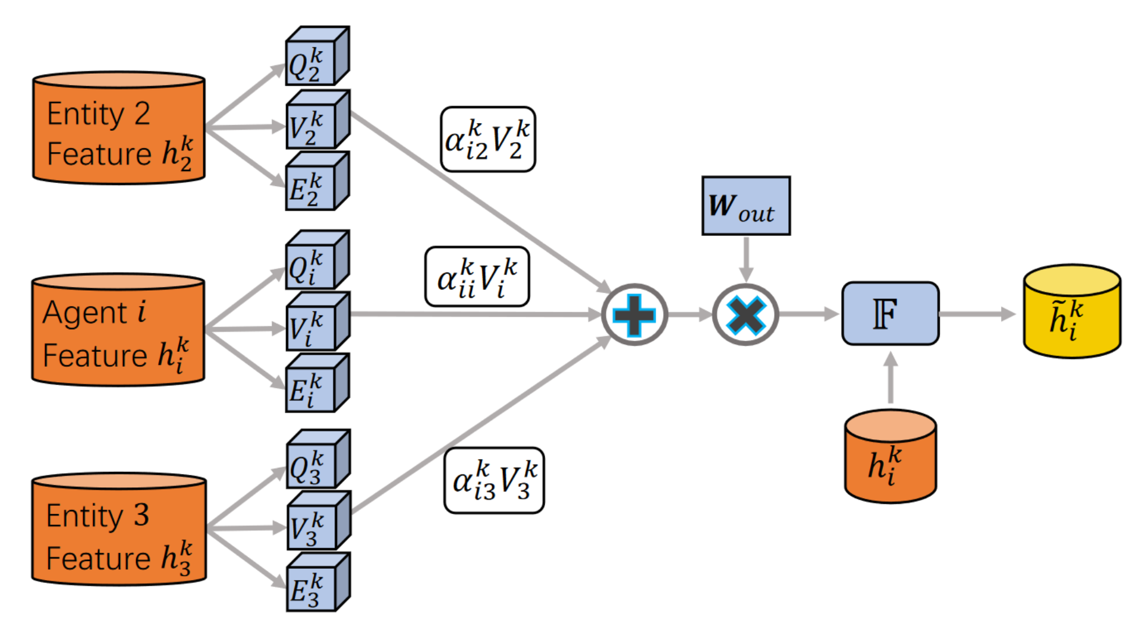
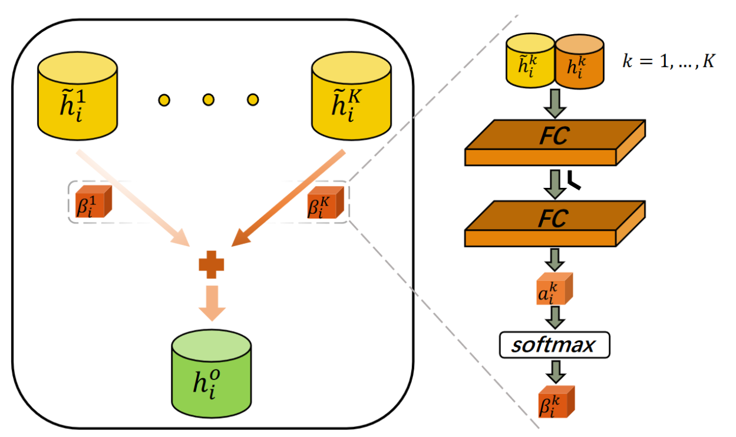
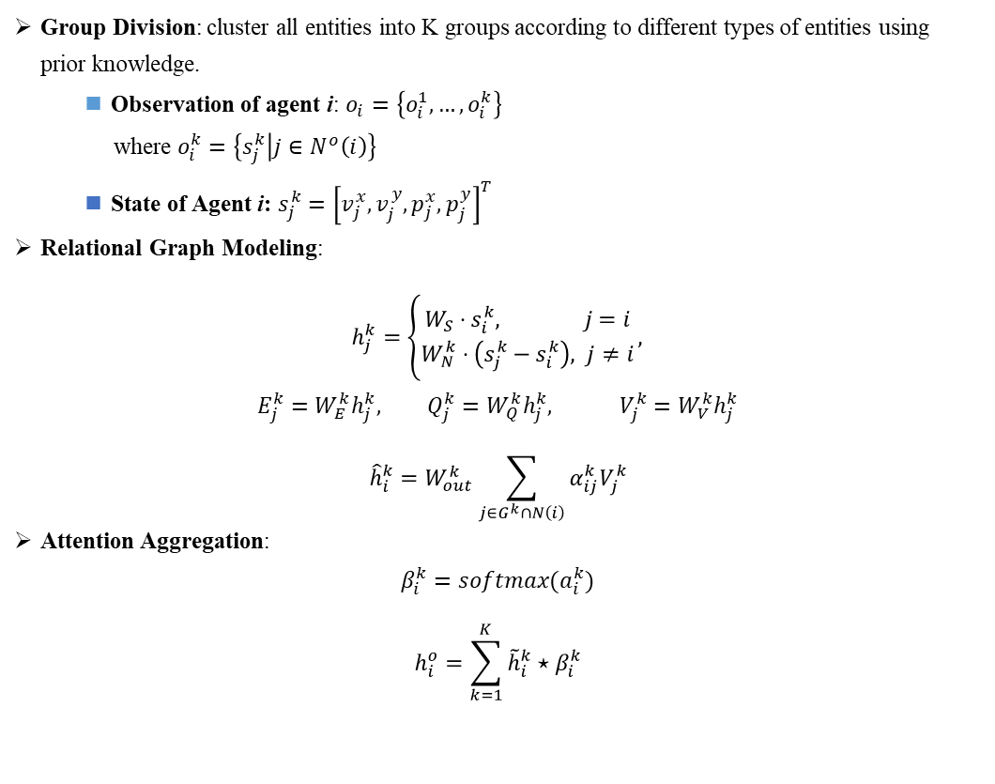
02
Method
RDGANet
Group Division: cluster all entities into K groups according to different types of entities using prior knowledge.
Observation of agent i: $o_{i}=\left\{o_{i}^{1},…,o_{i}^{k}\right\}$
where $o_{i}^{k}=\left\{s_{j}^{k} | j∈N^{o}\left(i\right)\right\}$
State of Agent i: $s_{j}^{k}={\left[v_{j}^{x},v_{j}^{y},p_{j}^{x},p_{j}^{y}\right]}^{T}$
Relational Graph Modeling:
$h_{j}^{k}=\left\{\begin{aligned}W_{S}⋅s_{i}^{k}, j=i \\ W_{N}^{k}⋅\left(s_{j}^{k}−s_{i}^{k}\right), j≠i\end{aligned}\right.,$
$$E_{j}^{k}=W_{E}^{k}h_{j}^{k}, Q_{j}^{k}=W_{Q}^{k}h_{j}^{k}, V_{j}^{k}=W_{V}^{k}h_{j}^{k}$$
$${\hat{h}}_{i}^{k}=W_{out}^{k}\sum_{j∈G^{k}∩N\left(i\right)}{α_{ij}^{k}V_{j}^{k}}$$
Attention Aggregation:
$$β_{i}^{k}=softmax(a_{i}^{k})$$
$$h_{i}^{o}=\sum_{k=1}^{K}{{\tilde{h}}_{i}^{k}⋆β_{i}^{k}}$$

Slide 10
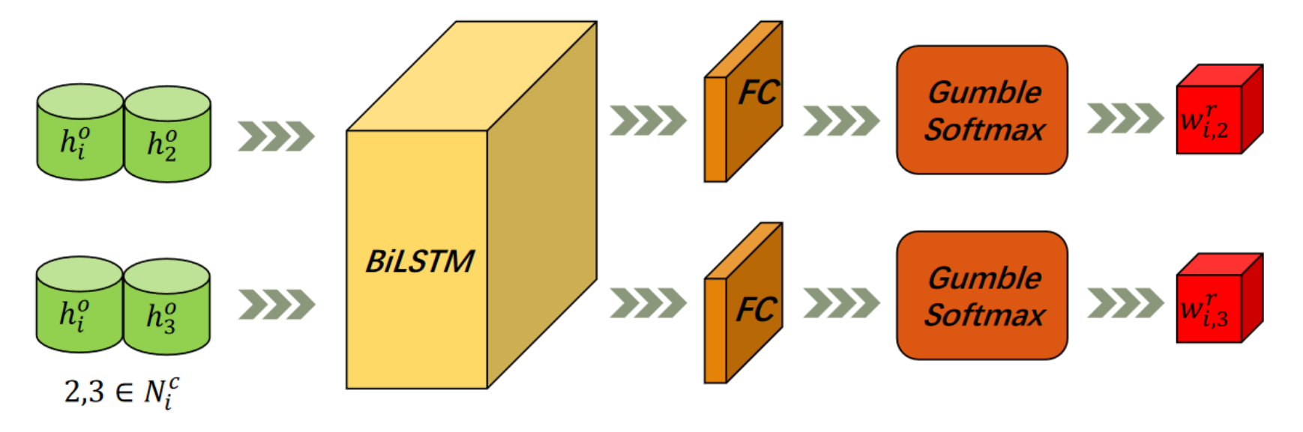
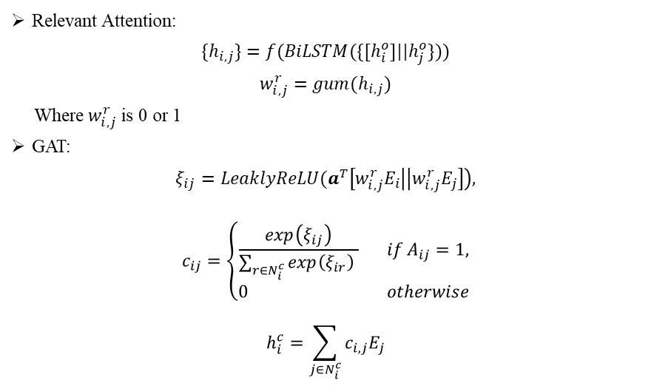
02
Method
RGAT
Full Connected Communication Topology
Relevant Attention
Relevant Attention:
$$\{h_{i,j}\}=f(BiLSTM(\{[h_{i}^{o}]||h_{j}^{o}\}))$$
$$w_{i,j}^{r}=gum(h_{i,j})$$
Where $w_{i,j}^{r}$ is 0 or 1
GAT:
$$ξ_{ij}=LeaklyReLU(a^{T}\left[w_{i,j}^{r}E_{i} | \left|w_{i,j}^{r}E_{j}\right]\right),$$
$$c_{ij}=\left\{\begin{aligned}\frac{exp\left(ξ_{ij}\right)}{\sum_{r∈N_{i}^{c}}{\exp\left(ξ_{ir}\right)} } if A_{ij}=1, \\ 0 otherwise\end{aligned}\right.$$
$$h_{i}^{c}=\sum_{j∈N_{i}^{c}}{c_{i,j}E_{j}}$$
Relevant Communication Topology
GAT
Interaction Embedding

Slide 11
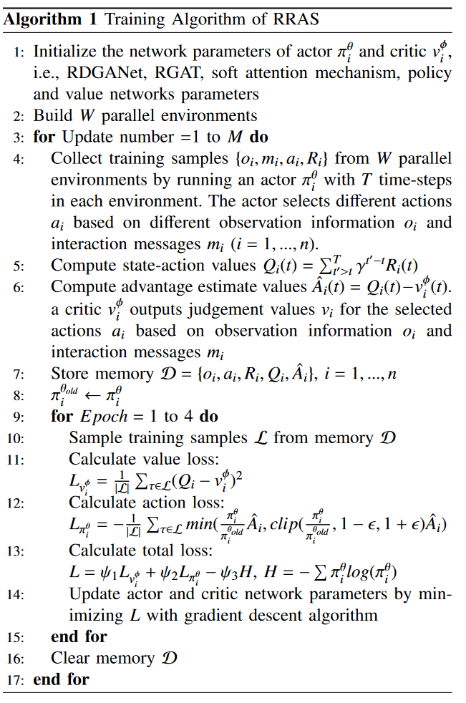
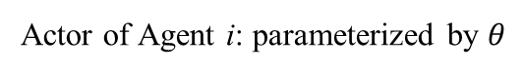
02
Method
Actor of Agent i: parameterized by $θ$

Slide 12
PART 3
Simulations
Simulation Setup
Results of Coverage
Results of Pursuit with Single Prey
Results of Pursuit with Multiple Preys
Ablation Studies

Slide 13
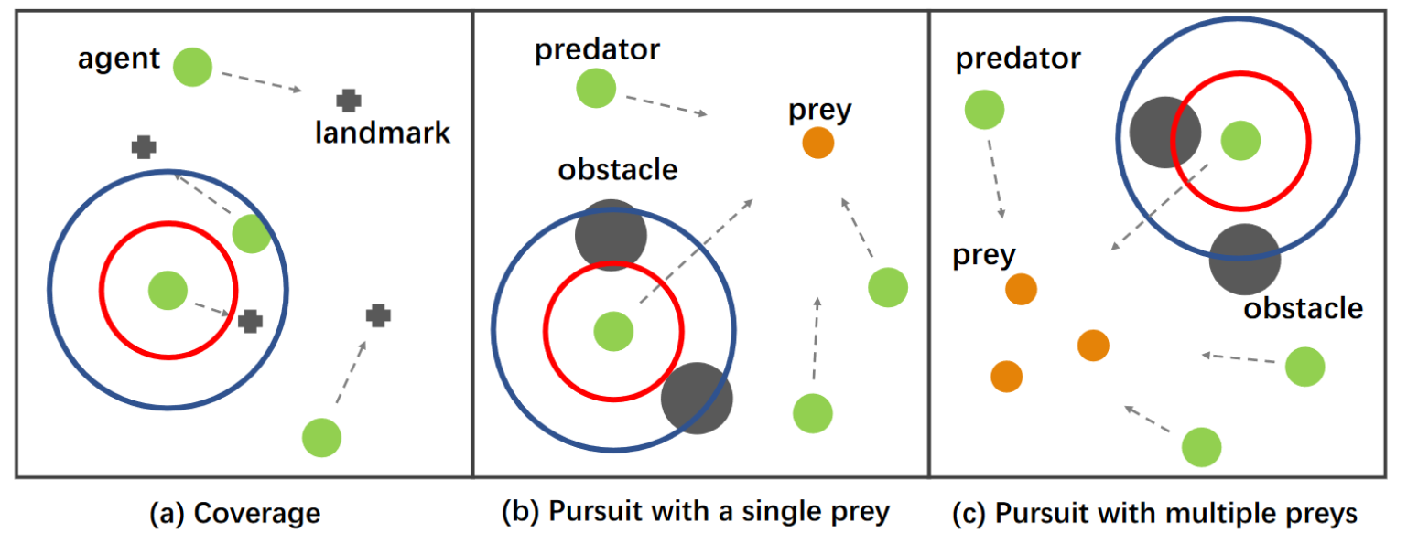
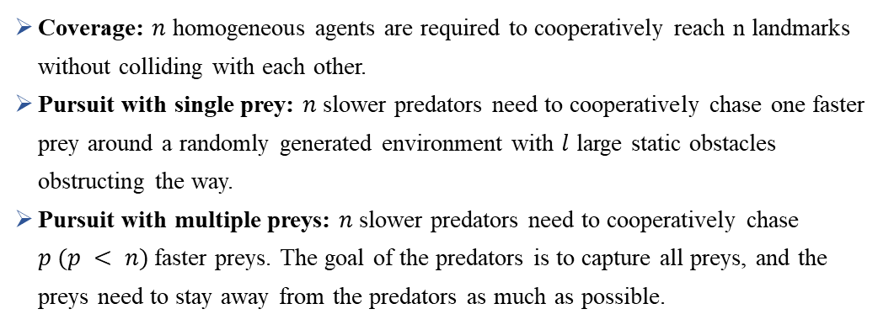
03
Simulations
Simulation Setup
Baselines:
LTCB: uses graph attention network to process the local observation and communication information of the agent, but does not group the local observation and remove redundant communication.
DyAN: uses graph neural network to deal with the local dynamic observation of the agent, and does not involve the attention mechanism.
AERL: the method uses graph attention network and LSTM to promote communication among agents.
Coverage: $n$ homogeneous agents are required to cooperatively reach n landmarks without colliding with each other.
Pursuit with single prey: $n$ slower predators need to cooperatively chase one faster prey around a randomly generated environment with $l$ large static obstacles obstructing the way.
Pursuit with multiple preys: $n$ slower predators need to cooperatively chase $p (p < n)$faster preys. The goal of the predators is to capture all preys, and the preys need to stay away from the predators as much as possible.
Metrics:
Success Rate(S%): Percentage of episodes the agents completed the task.
Mean episode reward (MER): Mean of episode reward for each agent.
Mean episode length (MEL): Mean of successful episode length. In addition, the update number (UN) of the network parameters also needs to be noted.

Slide 14
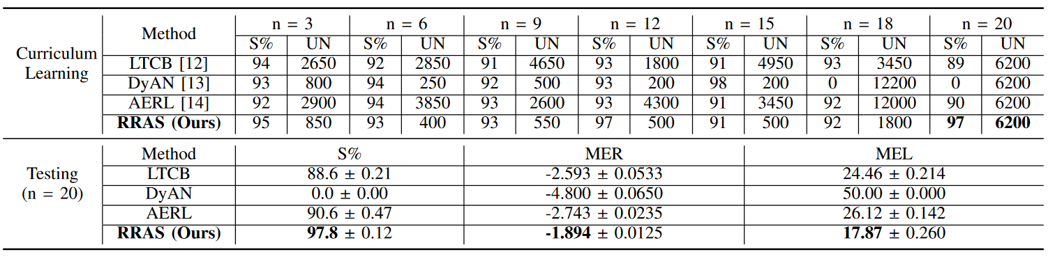
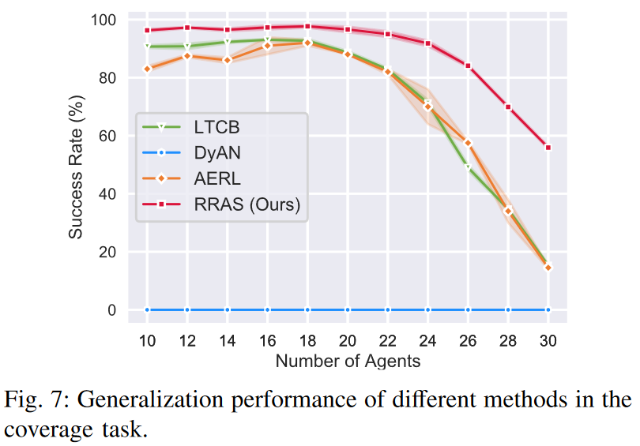
03
Simulations
Curriculum learning is implemented to speed up the learning
RRAS has faster convergence with a higher success rate (97.8%) compared with other methods.
Teams with less than 20 agents have better success rates than teams with more than 20 agents.
In more than 20 agents scenarios, RRAS still achieves better generalization performance than other methods

Slide 15
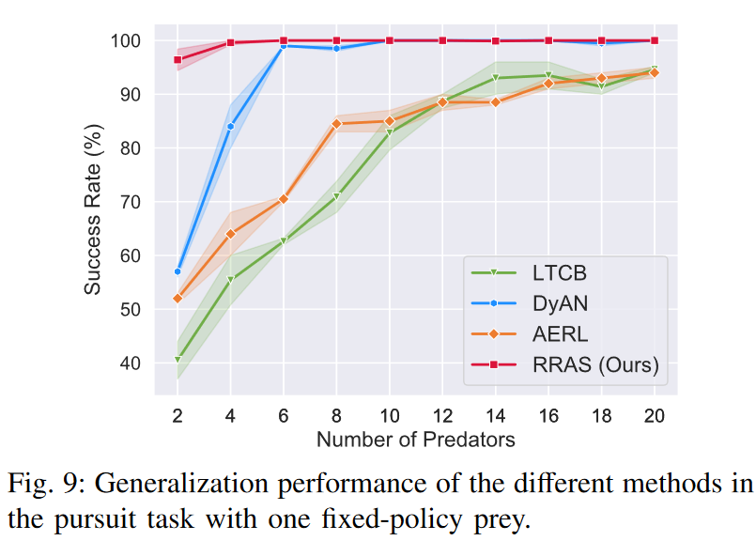
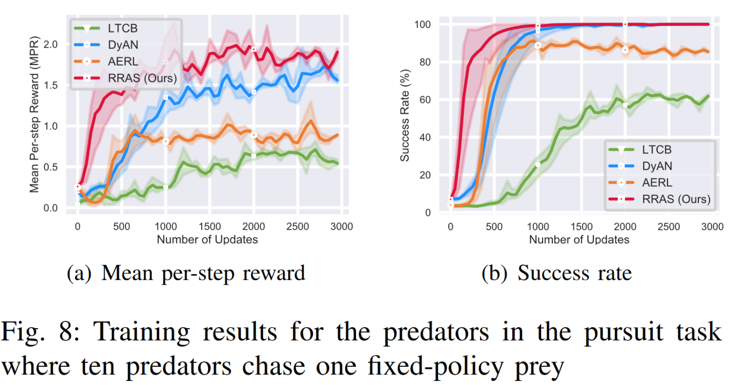
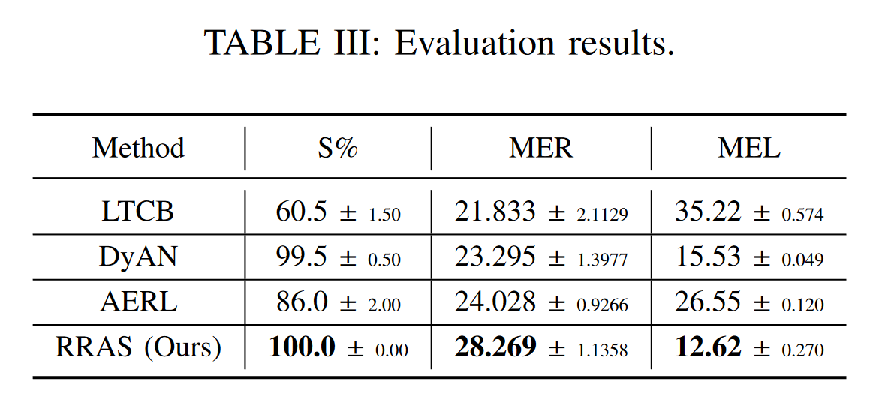
03
Simulations
RRAS have better performance than the other methods in terms of convergence rate
The predators performing the RRAS method can catch the prey faster than the other methods, along with higher rewards.
Fig.9 shows that RRAS has always maintained a high success rate, even when the number of predators is low.

Slide 16
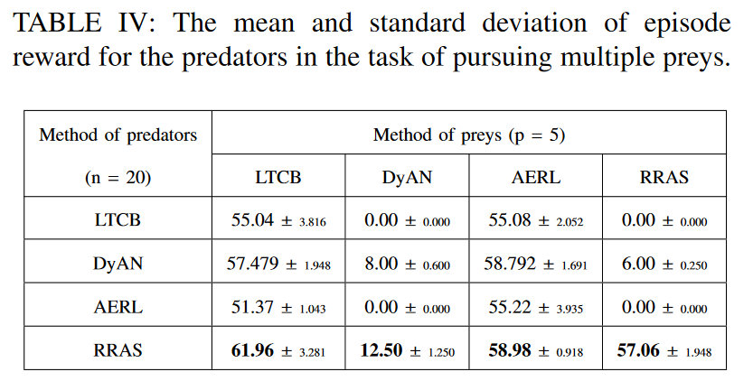
03
Simulations

Slide 17
PART 4
Comments

Slide 18

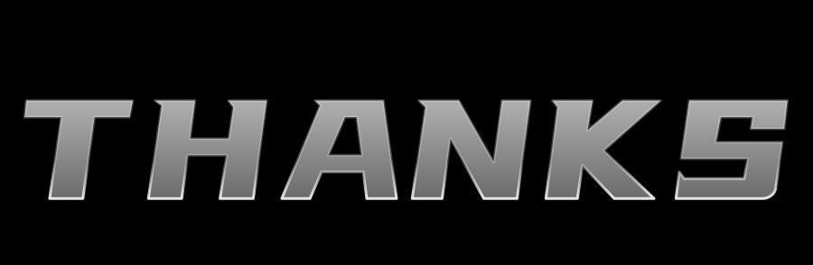
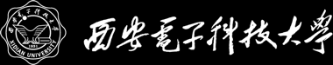
QUESTIONS & ANSWERS
汇报人
傅连浩
2023年9月18日

